Slide 1
Drone Swarms
Poojith U Rao
Somanath Yadavalli
Nishant Kumar

Slide 2
Introduction
The main purpose of our project is to use drones to scout the disaster areas or inaccessible terrain areas and report with the relevant data to the Cloud Data Centre for any analytics and processing.
As the rescue and recovery activity builds, drones provide a responsive, ‘bird’s eye view’ which assists in coordinating ongoing operations.

Slide 3
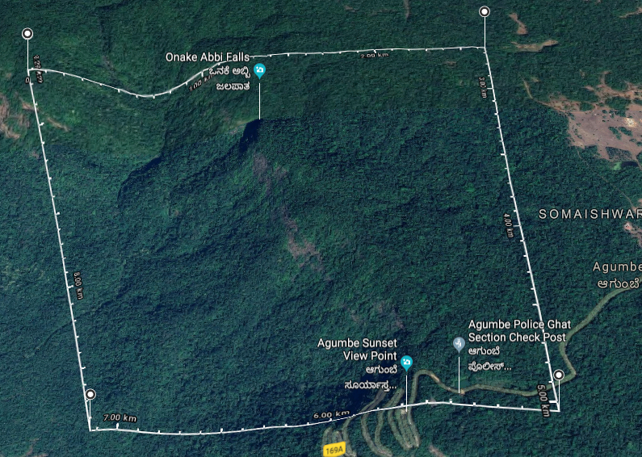

Introduction
The goal is to build completely autonomous drones capable of navigating, collecting and sharing vital information of the disaster. (e.g. The image on the right shows some reported areas of fire)

Slide 4
Literature Survey
DroneCode: https://www.dronecode.org/documentation/
PX4: http://dev.px4.io/en/
Gazebo9: http://gazebosim.org/
ROS: http://www.ros.org/

Slide 5
Problem Formulation
Multi-Drone simulation
D2D – pro active collision avoidance
Collaboration between drones and information

Slide 6
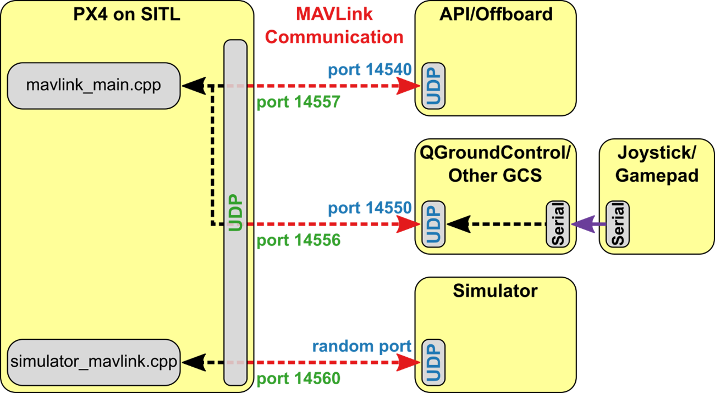
Block Diagram

Slide 7

Tools Used
It is an open source drone simulation software. It is used to simulate the path of the drone to get the visual understanding of the mathematical model of the flight path.
It provides flight controller hardware, auto-pilot software, ground control station and developer APIs for simulation of drones.

Slide 8
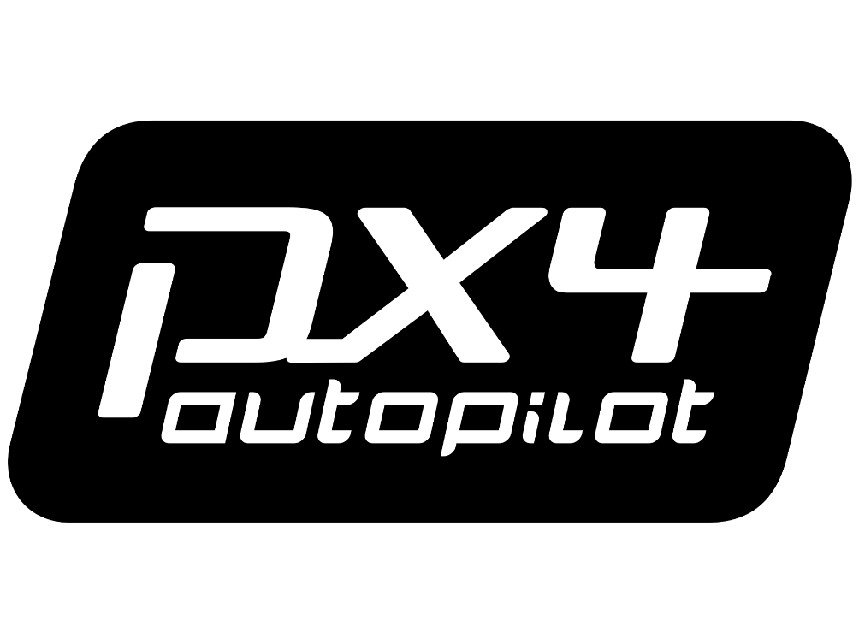
Tools Used
Pixhawk is an independent open-hardware project that aims to provide the standard for readily available, high quality and low cost auto pilot hardware designs for the academic, hobby and developer communities.
This hardware is simulated by dronecode.
Px4 powers the pixhawk hardware

Slide 9
Px4
This contains QGroundControl and MAVLink protocol.
All simulators communicate with PX4 using the Simulator MAVLink protocol. This protocol is provided as an API for simulation purposes. The API defines a set of MAVLink messages that supply sensor data from the simulated world to PX4 and return motor and actuator values from the flight code that will be applied to the simulated vehicle.

Slide 10
Gazebo for simulation
A powerful 3D simulation environment that is particularly suitable for testing object-avoidance and computer vision. We are using it for multi-vehicle simulation along with ROS, a collection of tools for automating vehicle control.
It supports various vehicles like Quad (Iris and Solo), Hex (Typhoon H480), Generic quad delta VTOL, Tailsitter, Plane, Rover, and will soon add Submarine.

Slide 11
Tools Used
MAVROS
The mavros ROS package enables MAVLink extendable communication between computers running ROS, MAVLink enabled autopilots, and MAVLink enabled GCS. MAVROS is the "official" supported bridge between ROS and the MAVLink protocol.

Slide 12
Drones with Cameras
Here we add cameras on drones for survelliance of particular Area.
To detect Objects.
To identify a fire hazard or flood effected areas.

Slide 13
OpenCV
OpenCV (Open Source Computer Vision Library) is an open source computer vision and machine learning software library.
The library has more than 2500 optimized algorithms.
These algorithms can be used to detect and recognize faces, identify objects, classify human actions in videos, track camera movements, track moving objects.

Slide 14
Applications
Used in monitoring during natural disasters.
communication relays
Crucially helpful in landslides and flood affected areas.
Detecting human in trouble
Fire accidents
Post disaster inspection and relief
Infrastructure inspection
Traffic surveillance

Slide 15
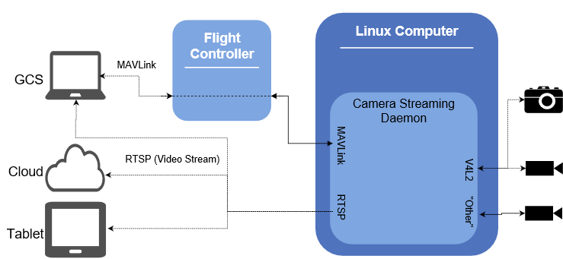
Block Diagram

Slide 16
Limitations
Public perception is a huge hurdle to overcome.
Sufficient drones may not be available all the time at all places.
Accuracy may not be up to the point since measurements are machine based.
Drones have limited coverage area.
Drones have a low battery life, usually for 20 minutes.
Battery may get further reduced due to weather conditions, flying in hilly areas etc.
Drones cannot cover the no-fly zones.

Slide 17
Future Enhancement
Used in military application.
Used for security defense systems.
It allows conventional forces to almost freely enter into a particular environment.
Used for Survelliance of particular Area.

Slide 18
Road Map
Attach cameras to drones.
Integrating OpenCV with ROS.
Use efficient algorithms to detect objects using OpenCV.
Design optimal missions for each drones to cover entire geographical area.
Detect the Coordinates of objects.

Slide 19
Thank You

